Slide 1
Introduction

Slide 2
Course Goals
  This course covers the core APIs that you use to design object-oriented applications with Java. This course also covers writing database programs with JDBC.
  Use this course to further develop your skills with the Java language and prepare for the Oracle Certified Professional, Java SE 8 Programmer Exam.
Notes:
Java SE 8 Programming 1 - <number>

Slide 3

Course Objectives
After completing this course, you should be able to do the following:
  Create Java technology applications that leverage the object-oriented features of the Java language, such as encapsulation, inheritance, and polymorphism
  Execute a Java application from the command line
  Create applications that use the Collections framework
  Search and filter collections by using Lambda Expressions
  Implement error-handling techniques by using exception handling
Notes:
Java SE 8 Programming 1 - <number>

Slide 4
Course Objectives
  Implement input/output (I/O) functionality to read from and write to data and text files and understand advanced I/O streams
  Manipulate files, directories, and file systems by using the NIO.2 specification
  Perform multiple operations on database tables, including creating, reading, updating, and deleting, by using the JDBC API
  Create high-performing multithreaded applications that avoid deadlock
  Use Lambda Expression concurrency features
Notes:
Java SE 8 Programming 1 - <number>

Slide 5
Audience
The target audience includes those who have:
  Completed the Java SE 8 Fundamentals course or have experience with the Java language, and can create, compile, and execute programs
  Experience with at least one programming language
  An understanding of object-oriented principles
  Experience with basic database concepts and a basic knowledge of SQL
Notes:
Java SE 8 Programming 1 - <number>

Slide 6
Prerequisites
To successfully complete this course, you must know how to:
  Compile and run Java applications
  Create Java classes
  Create object instances by using the new keyword
  Declare Java primitive and reference variables
  Declare Java methods by using return values and parameters
  Use conditional constructs such as if and switch statements
  Use looping constructs such as for, while, and do loops
  Declare and instantiate Java arrays
  Use the Java Platform, Standard Edition API Specification (Javadocs)
Notes:
Java SE 8 Programming 1 - <number>

Slide 7
Class Introductions
Briefly introduce yourself:
  Name
  Title or position
  Company
  Experience with Java programming and Java applications
  Reasons for attending
Notes:
Java SE 8 Programming 1 - <number>

Slide 8

Course Environment
Classroom PC
Core Apps
JDK 8
NetBeans 8.0
Additional Tools
  Firefox
  Java DB (Derby)
  Oracle Linux
Notes:
In this course, the following products are preinstalled for the lesson practices:
JDK 8: The Java SE Development Kit includes the command-line Java compiler (javac) and the Java Runtime Environment (JRE), which supplies the java command needed to execute Java applications.
Firefox: A web browser is used to view the HTML documentation (Javadoc) for the Java SE Platform libraries.
NetBeans 8.0: The NetBeans IDE is a free and open-source software development tool for professionals who create enterprise, web, desktop, and mobile applications. NetBeans 7.0.1 fully supports the Java SE 7 Platform. Support is provided by Oracle's Development Tools Support offering.
Java DB: Java DB is Oracle's supported distribution of the open-source Apache Derby 100% Java technology database. It is fully transactional, secure, easy-to-use,
standards-based SQL, JDBC API, and Java EE, yet small (only 2.5 MB).
Oracle Linux: Oracle's enterprise implementation of Linux. Compatible with RedHat Linux.
Java SE 8 Programming 1 - <number>

Slide 9
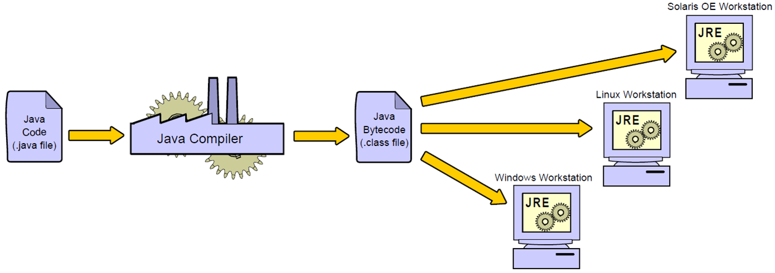
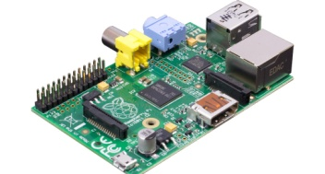
Java Programs Are Platform-Independent
Embedded device
Notes:
Platform-Independent Programs
Java technology applications are written in the Java programming language and compiled to Java bytecode. Bytecode is executed on the Java platform. The software that provides you with a runnable Java platform is called a Java Runtime Environment (JRE). A compiler, included in the Java SE Development Kit (JDK), is used to convert Java source code to Java bytecode.
Java SE 8 Programming 1 - <number>

Slide 10
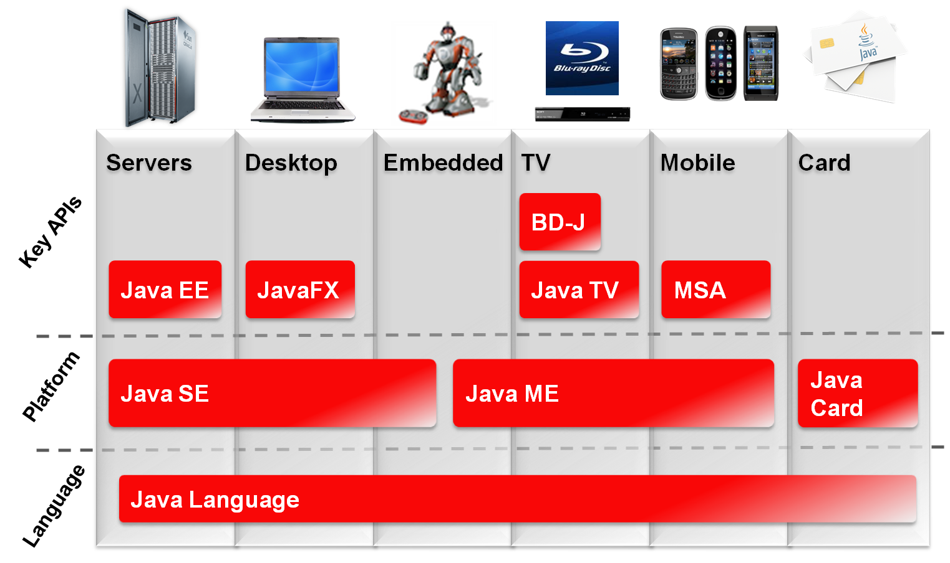






Java Technology Product Groups
Notes:
Identifying Java Technology Groups
Oracle provides a complete line of Java technology products ranging from kits that create Java technology programs to emulation (testing) environments for consumer devices, such as cellular phones. As indicated in the graphic, all Java technology products share the foundation of the Java language. Java technologies, such as the Java Virtual Machine, are included (in different forms) in three different groups of products, each designed to fulfill the needs of a particular target market. The figure illustrates the three Java technology product groups and their target device types. Among other Java technologies, each edition includes a Software Development Kit (SDK) that allows programmers to create, compile, and execute Java technology programs on a particular platform:
Java Platform, Standard Edition (Java SE): Develops applets and applications that run within web browsers and on desktop computers, respectively. For example, you can use the Java SE Software Development Kit (SDK) to create a word-processing program for a personal computer. You can also use the Java SE to create an application that runs in a browser.
Note: Applets and applications differ in several ways. Primarily, applets are launched inside a web browser, whereas applications are launched within an operating system.
Java SE 8 Programming 1 - <number>

Slide 11
Java SE Platform Versions
Year | Developer Version (JDK) | Platform
1996 | 1.0 | 1
1997 | 1.1 | 1
1998 | 1.2 | 2
2000 | 1.3 | 2
2002 | 1.4 | 2
2004 | 1.5 | 5
2006 | 1.6 | 6
2011 | 1.7 | 7
2014 | 1.8 | 8
Notes:
How to Detect Your Version
If Java SE is installed on your system, you can detect the version number by running java ‑version. Note that the java command is included with the Java Runtime Environment (JRE). As a developer, you also need a Java compiler, typically javac. The javac command is included in the Java SE Development Kit (JDK). Your operation system’s PATH may need to be updated to include the location of javac.
Java SE 8 Programming 1 - <number>

Slide 12
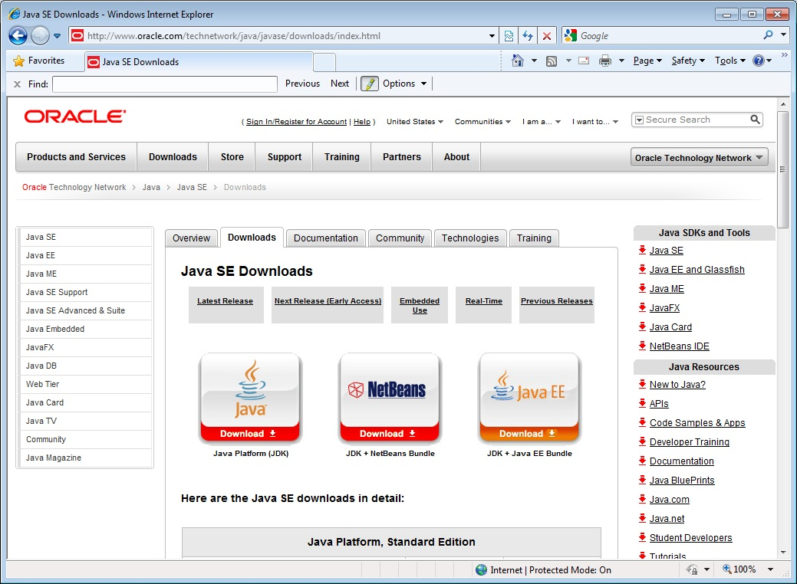
Downloading and Installing the JDK
Notes:
1. Go to http://www.oracle.com/technetwork/java/javase/downloads/index.html.
2. Choose the Java Platform, Standard Edition (Java SE) link.
3. Download the version that is appropriate for your operation system.
4. Follow the installation instructions.
5. Set your PATH.
Java SE 8 Programming 1 - <number>

Slide 13
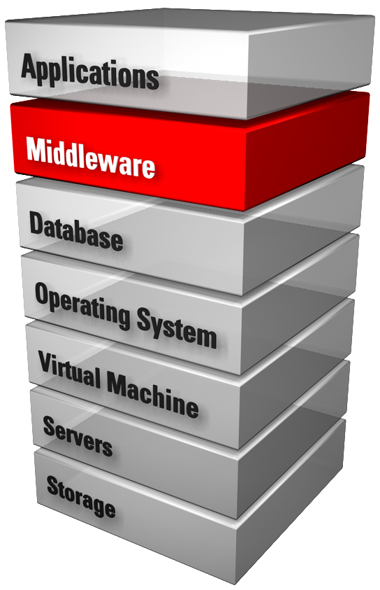
Java in Server Environments
Java is common in enterprise environments:
  Oracle Fusion Middleware
    Java application servers
      GlassFish
      WebLogic
  Database servers
    MySQL
    Oracle Database
Notes:
Enterprise Environments
In this course, you develop Java SE applications. There are standard patterns you need to follow when implementing Java SE applications, such as always creating a main method that may be different when implementing enterprise applications. Java SE is only the starting point in your path to becoming a Java developer. Depending on the needs of your organization, you may be required to develop applications that run inside Java EE application servers or other types of Java middleware.
Often, you will also need to manipulate information stored inside relational databases such as MySQL or Oracle Database. This course introduces you to the fundamentals of database programming.
Java SE 8 Programming 1 - <number>

Slide 14
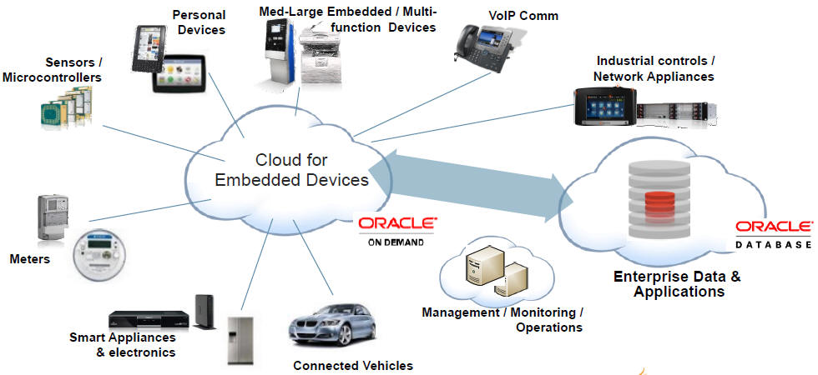
The Internet of Things
Devices on the “edge” represent a huge growth opportunity.
Notes:
Embedded Devices
Java SE 8 and Java ME 8 now share a common code base, and both are available in reduced footprint formats for embedded devices. An embedded device is typically a small controller or sensor that is part of a larger device. Embedded applications provide the intelligence required to support electrical and/or mechanical functions of an embedded device.
Some estimates put the number of connected devices at the edge of the network at 50 billion by the year 2020.
Java SE 8 Programming 1 - <number>

Slide 15













The Java Community
Mobile & Embedded
Notes:
What Is the Java Community?
At a very high level, Java Community is the term used to refer to the many individuals and organizations that develop, innovate, and use Java technology. This community includes developers as individuals, organizations, businesses, and open-source projects.
It is very common for you to download and use Java libraries from non-Oracle sources within the Java community. For instance, in this course, you use an Apache-developed JDBC library to access a relational database.
Apache Software Foundation
Java SE 8 Programming 1 - <number>

Slide 16
The Java Community Process (JCP)
The JCP is used to develop new Java standards:
  http://jcp.org
  Free download of all Java Specification Requests (JSRs)
  Early access to specifications
  Public review and feedback opportunities
  Open membership
Notes:
JCP.next
The JCP produces the JSRs that outline the standards of the Java platform. The behavior of the JCP itself is also defined and improved through the JSR process. The JCP is evolving and its improvements are defined in JSR-348. JSR-348 introduces changes in the areas of transparency, participation, agility, and governance.
Transparency: In the past, some aspects of the development of a JSR may have occurred behind closed doors. Transparent development is now the recommended practice.
Participation: Individuals and Java User Groups are encouraged to become active in the JCP.
Agility: Slow-moving JSRs are now actively discouraged.
Governance: The SE and ME expert groups are merging into a single body.
Java SE 8 Programming 1 - <number>

Slide 17
OpenJDK
OpenJDK is the open-source implementation of Java:
  http://openjdk.java.net/
  GPL licensed open-source project
  JDK reference implementation
  Where new features are developed
  Open to community contributions
  Basis for Oracle JDK
Notes:
Why OpenJDK Is Important
Because it is open source, OpenJDK enables users to port Java to operating systems and hardware platforms of their choosing. Ports are underway for many platforms (besides those already supported) including FreeBSD, OpenBSD, NetBSD, and MacOS X.
Java SE 8 Programming 1 - <number>

Slide 18
Oracle Java SE Support
Java is available free of charge. However, Oracle does provide pay-for Java solutions:
  The Java SE Support Program provides updates for
  end-of-life Java versions.
  Oracle Java SE Advanced and Oracle Java SE Suite:
    JRockit Mission Control
    Memory Leak Detection
    Low Latency GC (Suite)
    JRockit Virtual Edition (Suite)
Notes:
Still Free
Java (Oracle JDK) is freely available at no cost. Oracle offers advanced commercial solutions at cost. The previously offered “Java for Business” program has been replaced by Oracle Java SE Support, which provides access to Oracle Premier Support and the Oracle Java SE Advanced and Oracle Java SE Suite binaries. For more information, visit http://www.oracle.com/us/technologies/java/java-se-suite-394230.html.
Java SE 8 Programming 1 - <number>

Slide 19
Additional Resources
Topic | Website
Education and Training | http://education.oracle.com
Product Documentation | http://www.oracle.com/technology/documentation
Product Downloads | http://www.oracle.com/technology/software
Product Articles | http://www.oracle.com/technology/pub/articles
Product Support | http://www.oracle.com/support
Product Forums | http://forums.oracle.com
Product Tutorials | http://www.oracle.com/technetwork/tutorials/index.html
Sample Code | https://www.samplecode.oracle.com
Oracle Technology Network for Java Developers | http://www.oracle.com/technetwork/java/index.html
Oracle Learning Library | http://www.oracle.com/goto/oll
Notes:
The table in the slide lists various web resources that are available for you to learn more about Java SE programming.
Java SE 8 Programming 1 - <number>

Slide 20

Summary
In this lesson, you should have learned about:
  The course objectives
  Software used in this course
  Java platforms (ME, SE, and EE)
  Java SE version numbers
  Obtaining a JDK
  The open nature of Java and its community
  Commercial support options for Java SE
Notes:
Java SE 8 Programming 1 - <number>

